Slide 1

Business Meeting

Slide 2
NEUS
Hon Secretary Alistair Rogers
Administrator Deborah Wood
Hon Treasurer Matt Shaw
BAUS regional rep David Thomas

Slide 3
Agenda
GIRFT
BAUS SECTIONS
BAUS AUDIT
PHIN
MESH
ANNUAL MEETING
MANPOWER

Slide 4
GIRFT
Specialist nurse training and job planning
Diagnostic units (uiu)
Reduce elective activity whilst on call
Increased day case activity
Review MDT working
Stone pathways
UAN (hub and spoke)

Slide 5
SECTIONS
General Urology
Academic Urology
SURG

Slide 6
AUDIT
Costly and low quality data
Focused audits
Registry phased out
Private Hospital Information Network (PHIN)
Activity and basic outcome measures

Slide 7
MESH
Secretary of State for Health and CMO
“Pause or Restriction of use” July 10th
Clinical Advisory group BSUG and BAUS
Ongoing discussions MDTs, unit accreditation
Fewer patients receiving treatment for stress incontinence
Will mesh return ?

Slide 8
Annual Meeting
Glasgow 2019
General Urology
Sections sessions
Update
Network
Relax
CME
Excellent value

Slide 9
Training
Waypoints ST4,6
Emergency conditons checklist
Specialist Interest modules (pre CCT)
IST pilot
2019
20% posts ST1 benchmark ST3

Slide 10
JCST
New Curriculum standards
Shared outcomes, all surgical specialties
Progression points
Capabilities in Practice (CIP)
eg : managing ward round, theatre list,emergency take,Interpreting research……
Multiple Consultant Reports (MCR)

Slide 11
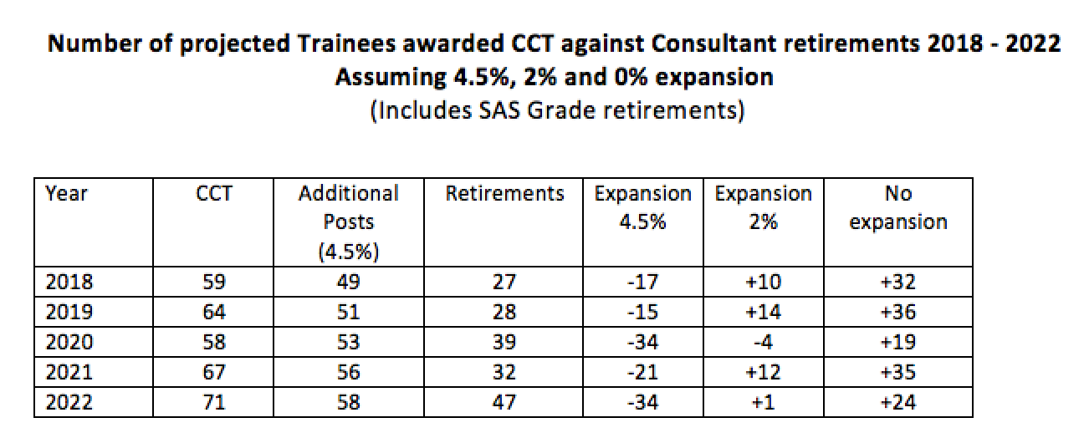
Manpower

Slide 12

Recruitment

Slide 13
Recruitment and Retention
Geography
Colleagues
Terms and Conditions
Facilities
Culture
Private Practice
Training experience
On call arrangements
Salary
Job Plan
Flexible sessions
Mentoring / support

Slide 14
Workforce
Consultants
Trust doctors
Specialist Nurses
Physician Associates
Flexible Jobplans
Family friendly,
60-65y

Slide 15
Questions

