Slide 1

Business Meeting 2019

Slide 2
NEUS
Hon Secretary Alistair Rogers
Administrator Deborah Wood
Hon Treasurer Matt Shaw
BAUS regional rep David Thomas

Slide 3
Agenda
Emergency Urology
AUDIT
MESH
ANNUAL MEETING
WORKFORCE

Slide 4
Provision of out of hours Emergency Urology Care May 2019
Rota 1:8
Category A
Admission discussed <12hrs
Consultant review < 24hrs
Reduce elective load
Theatre access
IR Network provision
Paediatric Torsion , local arrangements
Emergency urology CPD
Ureteric reimplant
If working after midnight rest time following day

Slide 5
SECTIONS
BSOT
Academic Urology Group
Vice President Election

Slide 6
AUDIT
Focused audits Section driven - engage
Cytoreductive nephrectomy
Benign Prostate - Outlet surgery
Registry phased out 2019
Private Hospital Information Network (PHIN)
NCIP (GIRFT)
HESS data

Slide 7
NCIP
National Clinical Improvement Programme
Support scrutiny of patient outcomes at individual consultant level.
Enable consultants to identify potential improvements to their clinical practice.
Promote learning to improve patient safety and outcomes.

Slide 8
NCIP
Pilot
5 centres
NHS digital
Consultant access only
PCNL
Nephrectomy
Cystectomy
Prostatectomy
Scrotal exploration
Circumcision
Hydrocele Repair
BOO surgery

Slide 9
PHIN
Private Hospital Information Network
Information open to patients
Casemix, hospital stay, complication
Charges
Patient feedback

Slide 10
MESH
Moratorium remains in place
NICE april 2019
Cumberlege report Jan 2020
MDT for Mesh removal surgery

Slide 11
Annual Meeting
Birmingham 2020
Past Present Future 75 years
Founded 1945
BAUS 2020 celebrations
BAUS TUF BJUI
October dinner Draper’s Hall
Income down

Slide 12
Training
IST pilot underway Gen Surgery / Vascular
No benchmarking at ST3
2020 National Selection
No funding for extra posts
Job Plan – recognise teaching roles
NSTC single day modules

Slide 13
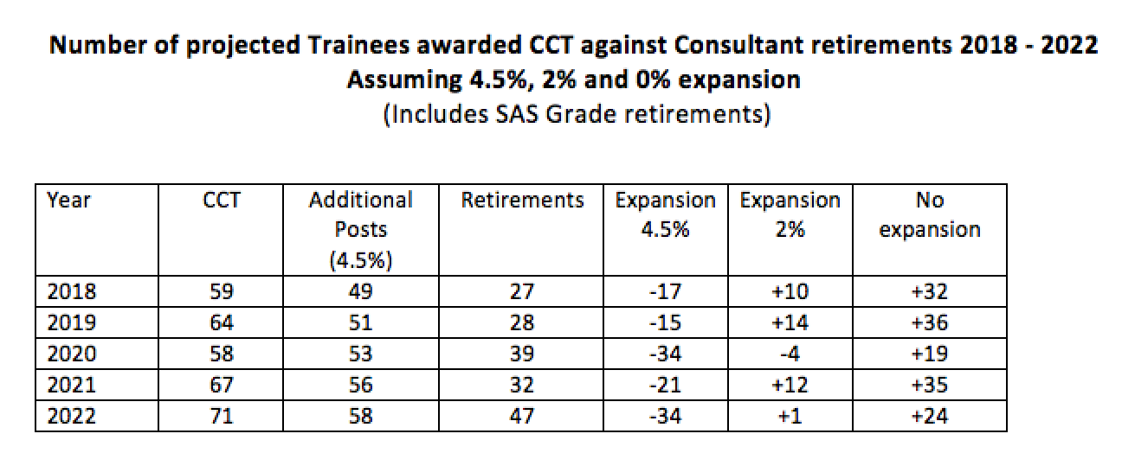
Manpower

Slide 14
Workforce
80% diagnostics
20% surgery
1113 consultants, 187 Assoc Specialists
319 SPR (35%F)
1:64,000
67 consultant posts unfilled

Slide 15
Managing Careers
Planning – 5 year cycles
Work Life 12PA ?
Half Day
Pension advice
Limited companies
Flexible contracts
Job share

Slide 16
Final Years
Average age retirement 62y
Come off on call at 60y
Reduce major surgery
Diagnostics
Mentoring
Teaching
Flexible Job Plans 8-10 PA

Slide 17
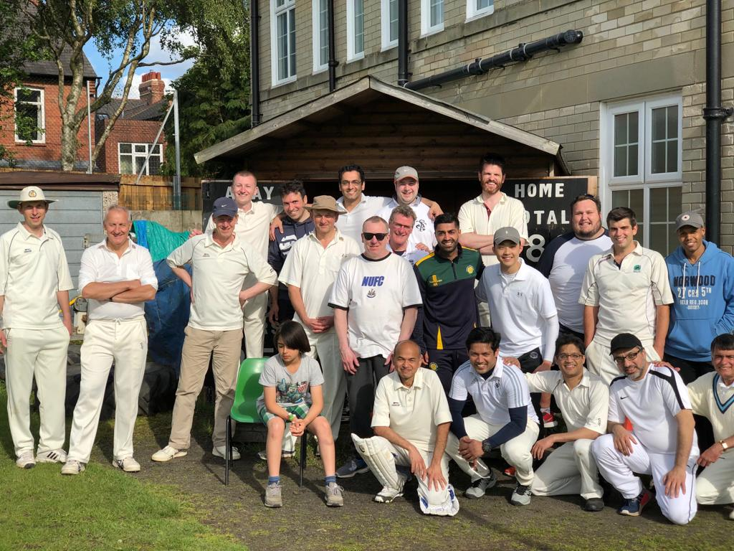
NEUS cricket

Slide 18
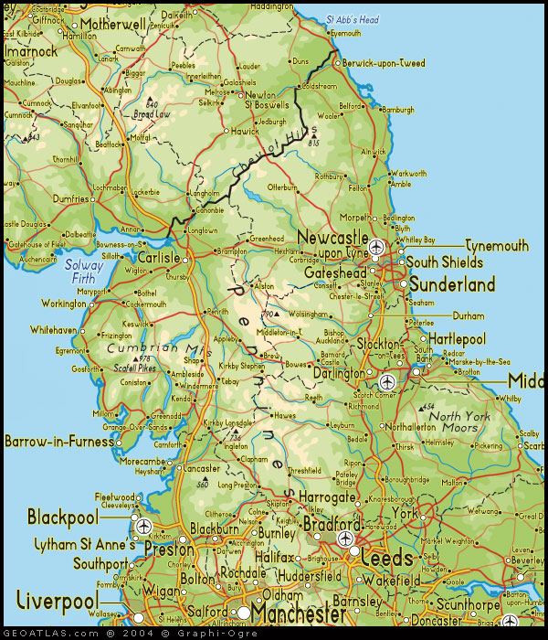
Region Feedback

Slide 19
Treasurer’s Report
Matt Shaw

