Slide 1

Use & utility of urine cytology in surveillance for NMIBC
Chloe Roy, Ashwin Sachdeva, Andy Thorpe
Freeman Hospital, Newcastle

Slide 2
Urine cytology
Assessment of exfoliated cells of the urinary tract
High specificity
  94-99%
High sensitivity
  high grade TCC (>80%)
  CIS (98-99%)
Poor sensitivity for low grade TCC

Slide 3
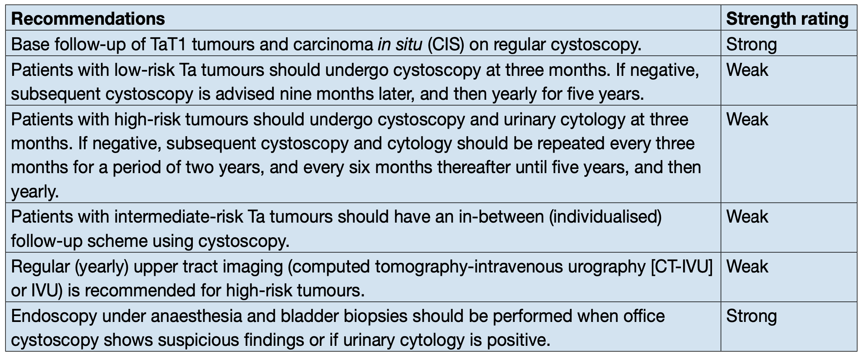
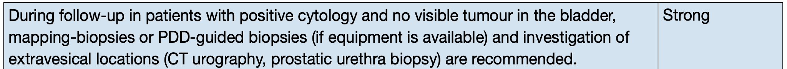
Urine cytology
EAU guidelines for high risk NMIBC
Paris classification
Negative
LGUN
Atypical
Suspicious HGUN
Suspicious HGUN
HGUN
Risk of malignancy:
50-90%
>90%
0-10%
10%
8-35%

Slide 4
Method
Patients undergoing surveillance flexible cystoscopy for NMIBC
327
Retrospective review
3 months (Oct-Dec 19)
N = 418 patients
Exclusions:
  No record
  No TCC history
  Upper tract primary
  MIBC
Urine cytology
sample taken
84 (26%)
Suspicious results
19 (23%)
Bladder biopsy performed
11 (58%)
Confirmed recurrence
6 (55%)

Slide 5
Results
Urine cytology
Performed in 75 high-risk patients (50%)
Abnormal cytology: 9 patients
…with normal flexi: 2
  Biopsied = 0
  CT suggestive of upper tract recurrence = 0
…with abnormal flexi: 7
  Biopsied = 6 (malignant 67%)
  CT suggestive of upper tract recurrence = 0
Patient characteristics
Median age: 73 years, 77% male
Median time since diagnosis: 48 months
Urine cytology result | Biopsy done (n=10)
 | Benign | Malignant | Not done
Normal | 3 | 1 | 62
HGUC/sHGUC | 2 | 4 | 3

Slide 6
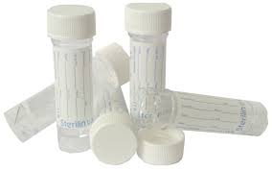
Conclusion
Urine cytology indicated but not performed in 50% of high-risk patients
  Debate regarding benefit of urine cytology as part of surveillance
Finding of abnormal urine cytology with normal flexible cystoscopy did not alter subsequent management
Cost implications

