Slide 1
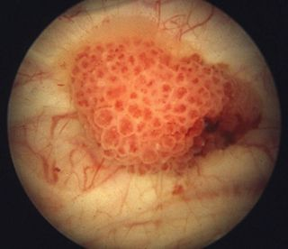

A Cut Above the Rest? TURBT Operative Notes; a Quality Focused Review
Nikhil Dhir, Tom O’Hare, Fawad Arif, Stuart McCracken
Sunderland Royal Hospital/James Cook University Hospital

Slide 2


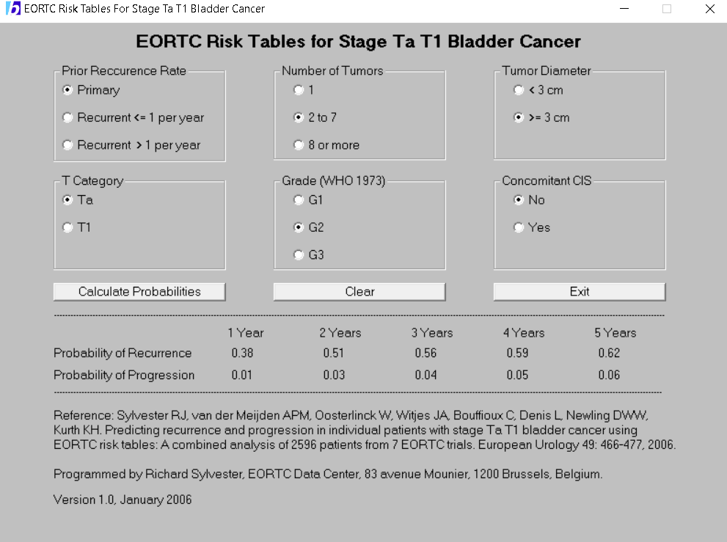
TURBT: Diagnosis or Treatment?
Both!
Recurrence and Progression prediction
“Maximal TURBT”

Slide 3

Aims and Methods
100 TURBT Operative notes
20 Key metrics measured:
  Good Surgical Practice Guidelines 2014 → 15 metrics
  TURBT specific → 5 metrics

Slide 4
Good Surgical Practice Metrics
Metric | Percentage Documented in 100 cases | Rating
1. Date of Operation | 100% | Excellent
2. Type of Operation: Elective or Emergency | 100% | Excellent
3. Surgeon name | 100% | Excellent
4. Anaesthetist name | 81% | Excellent
5. Procedure name | 100% | Excellent
6. Antibiotics given | 56% | Fair
7. Estimated blood loss? | 0% | Very Poor
8. Access | 94% | Excellent
9. Operative Diagnosis | 100% | Excellent
10. Complications: yes or no | 19% | Very Poor
11. Additional procedure: yes or no | 12% | Very Poor
12. Tissue removed? | 100% | Excellent
13. Catheter placed? | 89% | Excellent
14. Post-operative instructions? | 100% | Excellent
15. DVT prophylaxis and anticoagulation | 100% | Excellent

Slide 5
TURBT Specific Metrics
Metric | Percentage Documented in 100 cases | Rating
1. Tumour size (cm) | 46% | Fair
2. Tumour Number (n) | 49% | Fair
3. Prior recurrence rate/year | 70% | Good
4. EUA | 60% | Good
5. Mitomycin given | 47% | Fair

Slide 6
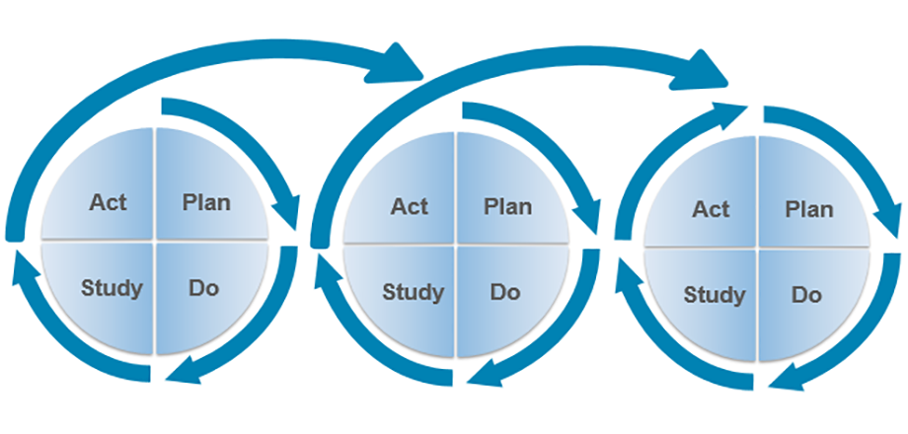
Whats next?
Standardised proforma including TURBT specific metrics. Use for re-audit

Slide 7

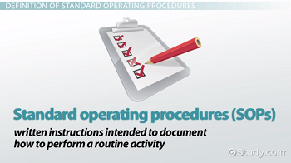
Take Home Messages
Operation notes as a marker of quality in patient care
This is particular the case for TURBT
Use of a Standardised Proforma for TURBT should raise standards

