Slide 1


Uretero-ileal anastomotic strictures rates:
Bricker versus Wallace;
A single centre study
Tom O’Hare, Varshini Ghananbalan, Mohammed Elawad, Yasmine Wilczek, Helen Scullion, Brian Chaplin, Simon Fulford, Jo Cresswell
James Cook University Hospital
Notes:
Data comparing the incidence of ureteroenteric strictures for Bricker and Wallace anastomoses are limited. This study compares both anastomotic techniques in terms of ureteroenteric stricture rates after radical cystectomy and ileal conduit urinary diversion

Slide 2


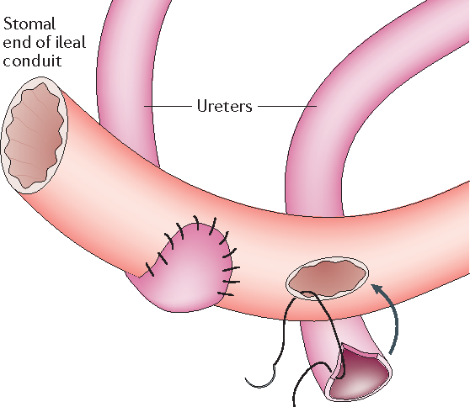
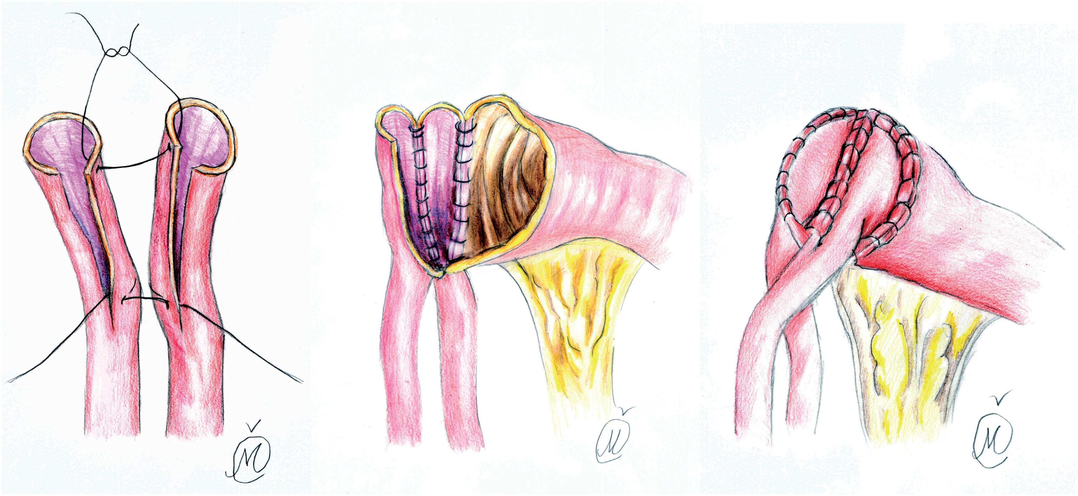
Bricker Vs Wallace
First described in the early 1950s, involves spatulating and anastomosing each ureter to the serosa of the bowel segment separately
Ureters are spatulated and sutured together with continuous suture, while the lateral edges of the newly conjoined ureters are anastomosed to the proximal end of an open ileal conduit segment
Notes:
Bricker – First described 1950, To create the urinary conduit, an ileum segment is harvested in isoperistaltic orientation. The ureters are anastomosed to the proximal end of the conduit and the distal end is used to perform a cutaneous stoma for urine drainage, which is externally connected to a collection device attached to the skin
Bricker EM. Bladder substitution after pelvic evisceration. Surg Clin North Am1950;30:1511–21.doi:10.1016/S0039-6109(16)33147-4
2011 study -no convincing evidence in the literature demonstrating a better quality of life offered by any type of urinary diversion.
Shih C, Porter MP Health-related quality of life after cystectomy and urinary diversion for bladder cancer. Adv Urol2011;2011:1–5.doi:10.1155/2011/715892
Wallace –
Fig
Modified Wallace anastomotic technique reduces ureteroenteric stricture rates after ileal conduit urinary diversion
Petar Kavaric, Sabovic Eldin, Radovic Nenad, Pratljacic Dragan, Marko Vukovic
Int Braz J Urol. 2020 May-Jun; 46(3): 446–455. Published online 2020 Feb 20. doi: 10.1590/S1677-5538.IBJU.2019.0417
PMCID: PMC7088478

Slide 3
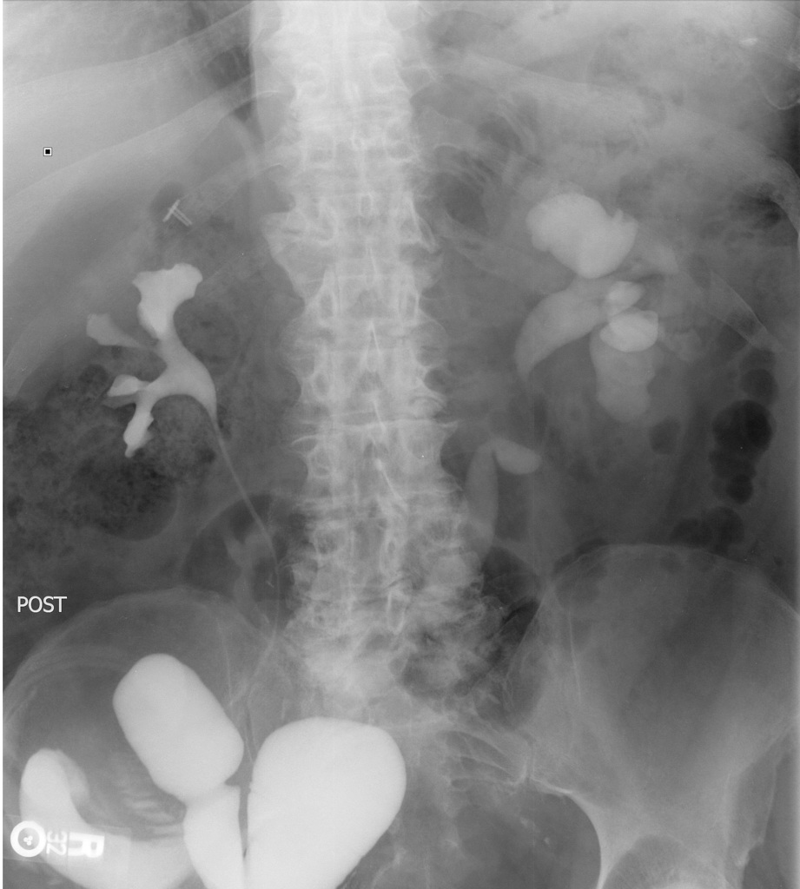
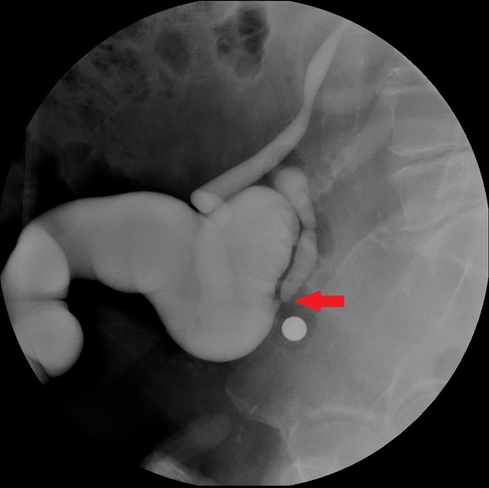
Uretero-ileal anastomotic stricture
Progressive hydronephrosis and/ or demonstrable absent ureteric reflux on imaging
USS – Highly sensitive but low specificity
CTIVU – Able to analyse soft tissue urinary diversion
Loopogram/ Renogram – Dynamic evaluation of the ileal conduit
Predisposing Factors
Ischaemic necrosis
Radiotherapy
Extravasation at the anastomosis
Left sided (Mobilisation higher)
High BMI
Notes:
The diagnosis of an anastomotic stricture is made when an intravenous urogram, renal ultrasound, or CT scan demonstrates progressive hydronephrosis and/or a loopogram demonstrates the absence of ureteral reflux in a patient in whom the diagnosis of a stricture is being entertained.
Ultrasound examination in this situation, although highly sensitive, demonstrates a specificity of only 50% because of the high prevalence of dilated collecting systems that are not obstructed in patients with ureteroileostomies . Both antegrade and retrograde studies are performed in an attempt to define the site, length, degree of narrowing, and possible etiology of the stricture. Brush biopsies are performed if there is a concern that the stricture may be malignant
https://www.alpfmedical.info/urinary-tract-collecting-system/ureteroenteral-anastomotic-strictures.html#:~:text=Ureteroenteral%20Anastomotic%20Strictures.%20The%20radiologic%20management%20of%20a,balloon%20catheter%20to%20the%20site%20of%20the%20stricture.
An ileal loop conduit can be investigated with either retrograde urography (loopogram) or with CT urography (CTU), and both have advantages and disadvantages.
CTU allows one to investigate the soft tissues around the urinary diversion more thoroughly than a loopogram does. If there is thickening of the ureter, mass effect on the ileal conduit or ureter, or a filling defect, a CTU may be able to characterise it with more specificity than a loopogram can.
A loopogram, on the other hand, allows a dynamic component to the evaluation of the ileal conduit. A narrowing can be mildly stressed with pressure from contrast and one can watch if the narrowing is fixed and over what length. The rate of opacification (and voiding) also offers diagnostic information
https://radiopaedia.org/cases/ureteroileal-anastomotic-stricture-ileal-conduit
predisposing factors are ischemic necrosis and subsequent fibrosis and stricture, due to excessive mobilization and skeletonization of the ureter. Preoperative radiation therapy appears to have a compounding effect. Extravasation at the anastomosis may progress to scarring and subsequently a stricture, and, rarely, recurrent tumor in the ureter may present with obstruction. Stenoses tend to be more prevalent on the left side, probably because of the necessity for high mobilization of the left ureter (to ensure a gradual course to the right), which often requires the middle ureteric artery to be sacrificed
Images
Loopogram –uretero ileal conduit stricture
post void images (draining the conduit), the right upper collecting system decompresses, but the left does not decompress very well and retains a faintly dilated appearance.

Slide 4

Background studies are limited…
Evangelidis et al. 2006 – 237 cohort – No statistical difference overall, Bricker strictures occur earlier
Davis et al. 2015 meta-analysis – No statistical difference
Liu et al 2014. and Kouba et al.2015 – No statistical difference but suggest assessing BMI
Richards et al. 2015 – Left sided strictures more common
Christoph et al. 2019 -135 cohort – Bricker had higher stricture rate but patients followed up 36months vs 17months Wallace
Kavaric et al 2020 – 140 cohort – Bricker had a higher stricture rate but low [patient data 8 Bricker vs 2 Wallace
Initial stricture rate higher in Bricker technique
Following 34 months equal rates
Increased stricture rate in higher BMI
Increased stricture rates on the left side
No statistical difference in techniques and stricture rate
Notes:
there have only been four publications and one meta-analysis that evaluate the benefits and harms of each implantation strategy of the ureter
…
8. Evangelidis A, Lee E, Karellas M, et al. Evaluation of ueretrointestinal anastomosis: Wallace vs Bricker. J Urol. 2006;175:1755–1758. [PubMed] [Google Scholar]
9. Richards K, Cohn J, Large M, et al. The effect of length of ureteral resection on benign ureterointestinal stricture rate in ileal conduit or ileal neobladder urinary diversion following radical cystectomy. Urol Oncol. 2015;33:65. [PubMed] [Google Scholar]
10. Davis N, Burke J, McDermott T, et al. Bricker versus Wallace anastomosis: a meta-analysis of ureteroenteric stricture rates after ileal conduit urinary diversion. Can Urol Assoc J. 2015;9:E284–E290. [PMC free article] [PubMed] [Google Scholar]
11. Liu L, Chen M, Li Y, et al. Technique selection of bricker or Wallace ureteroileal anastomosis in ileal conduit urinary diversion: a strategy based on patient characteristics. Ann Surg Oncol. 2014;8:2808–2812. [PubMed] [Google Scholar]
12. Kouba E, Sands M, Lentz A, et al. A comparison of the Bricker versus Wallace ureteroileal anastomosis in patients undergoing urinary diversion for bladder cancer. J Urol. 2007;178:945–949. [PubMed] [Google Scholar]
Ureteroenteric strictures: a single center experience comparing Bricker versus Wallace ureteroileal anastomosis in patients after urinary diversion for bladder cancer. Frank Christoph, Franziska Herrmann, Peter Werthemann, Thomas Janik, Martin Schostak, Christian Klopf, Steffen Weikert. BMC Urol. 2019; 19: 100. Published online 2019 Oct 24. doi: 10.1186/s12894-019-0529-6. PMCID: PMC6813097
The stricture rate was significantly higher when Bricker technique was applied. patients with a higher BMI were more likely to develop stricture.
Modified Wallace anastomotic technique reduces ureteroenteric stricture rates after ileal conduit urinary diversion
Petar Kavaric, Sabovic Eldin, Radovic Nenad, Pratljacic Dragan, Marko Vukovic
Int Braz J Urol. 2020 May-Jun; 46(3): 446–455. Published online 2020 Feb 20. doi: 10.1590/S1677-5538.IBJU.2019.0417
PMCID: PMC7088478

Slide 5
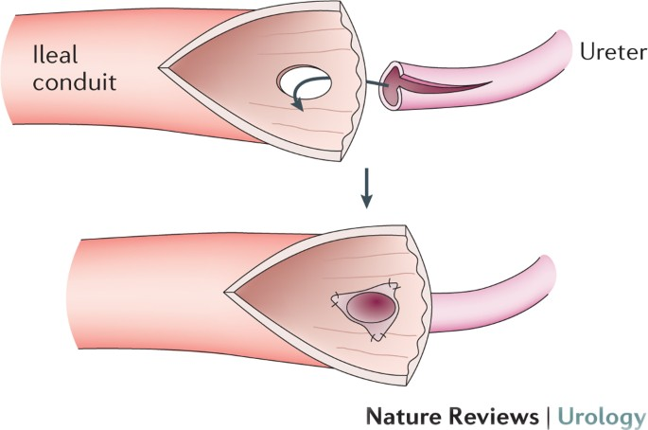
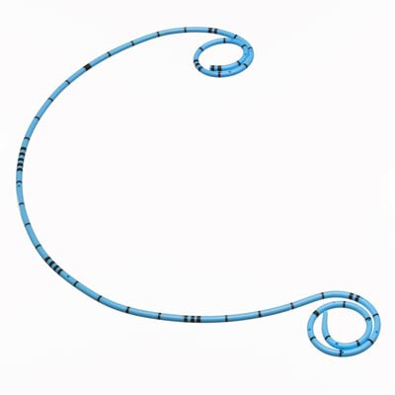
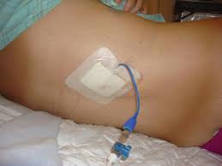

What measures did we use?
304 patients from 2005-2015 with 5 year followup
  251 Wallace
  53 Brickers

Slide 6

Data
Stricture rates:
  16/304: 5.2%
  Wallace 12/251: 4.7%
  Bricker 4/53: 7.5%
Duration to stricture?
  Average 5.5 months (1-12months)
Laterality?
  LEFT: 69%
  RIGHT: 13%
  Both: 18%
Management?
  8 Stents
  1 PCN
  4 reimplanted
  2 Nephrectomies
  1 revised

Slide 7



Conclusion

