Slide 1


TREXIT:
Safe transition to local anaesthetic transperineal prostate biopsies
Vikram Sehgal, Ashwin Sachdeva, Tariq Dosani, Rahul Gujadhar,
Edgar Paez, Bhavan Rai,
Rajan Veeratterapillay
Freeman Hospital, Newcastle

Slide 2
Transrectal ultrasound guided Biopsy (TRUS-Bx)
Historically TRUS-Bx was the gold standard
Risk of urosepsis
  Ranging between1-3%^{[1,2,3]}
  Due to introduction of rectal flora
Necessitating the use of broad-spectrum antibiotics
(often oral ciprofloxacin and metronidazole suppositories)
Notes:
[1] Deepak Batura, Guduru Gopal Rao, The national burden of infections after prostate biopsy in England and Wales: a wake-up call for better prevention, Journal of Antimicrobial Chemotherapy, Volume 68, Issue 2, February 2013, Pages 247–249, https://doi.org/10.1093/jac/dks401
[2] Prostate Cancer UK. 2020. Prostate Biopsy. [online] Available at: <https://prostatecanceruk.org/prostate-information/prostate-tests/prostate-biopsy> [Accessed 5 November 2020].
[3] Evans, R., Loeb, A., Kaye, K., Cher, M. and Martin, E., 2017. Infection-Related Hospital Admissions After Prostate Biopsy in United States Men. Open Forum Infectious Diseases, 4(1).

Slide 3
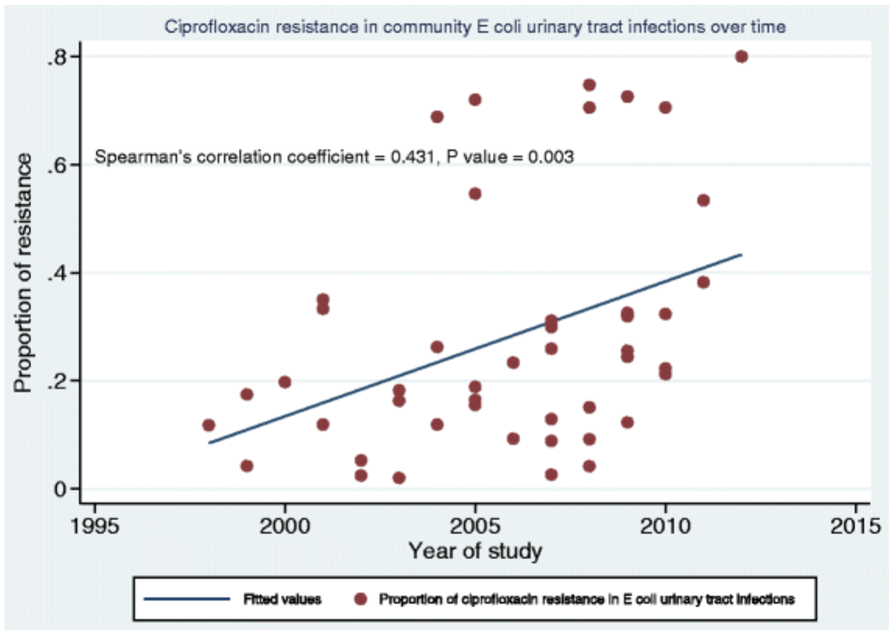
Antibiotic Usage
[1]
Fluoroquinolones – specifically ciprofloxacin
Rising antibiotic resistance
Need for antibiotic stewardship
Notes:
[4] Fasugba, O., Gardner, A., Mitchell, B. and Mnatzaganian, G., 2015. Ciprofloxacin resistance in community- and hospital-acquired Escherichia coli urinary tract infections: a systematic review and meta-analysis of observational studies. BMC Infectious Diseases, 15(1).

Slide 4
Transperineal Biopsy (TP-Bx) introduced
Switched locally to LA TP prostate biopsy in July 2019
Rationale
  Reduced sepsis risk
  Reduced antibiotic requirement
However there are still ongoing doubts regarding risk of urinary retention

Slide 5
Methodology
3 months before = TRUS (n=125)
3 months after = TP (n=142)
Data collection (at 30-day follow-up)
  Incidence of urosepsis
  Incidence of urinary retention

Slide 6
Findings
TP – no patients had sepsis or urinary retention
TRUS - 1 patient had sepsis (0.7%) and no urinary retention
Comparison with existing literature:
 | Transrectal | Transperineal
Urosepsis | 1-3%^{[1,2,3]} | <1%^{[5,6]}
Urinary retention | <1%^{[8,9]} | 1.6-11.4%^{[7]}
Notes:
[5] Skouteris V.M., Crawford E.D., Mouraviev V., Arangua P., Metsinis M.P., Skouteris M., Zacharopoulos G., Stone N.N. Transrectal Ultrasound-guided Versus Transperineal Mapping Prostate Biopsy: Complication Comparison. Rev. Urol. 2018;20:19–25. doi: 10.3909/riu0785
[6] Walker JT, Singla N, Roehrborn CG. Reducing infectious complications following transrectal ultrasound-guided prostate biopsy: A systematic review. Rev Urol. 2016;18:73–89.
[7] Kum, F., Jones, A. and Nigam, R., 2018. Factors influencing urinary retention after transperineal template biopsy of the prostate: outcomes from a regional cancer centre. World Journal of Urology, 37(2), pp.337-342.
[8] Berger AP, Gozzi C, Steiner H et al. Complication rate of transrectal ultrasound‐ guided prostate biopsy: a comparison among three protocols with 6, 10 and 15 cores. J Urol2004; 171: 1478–1480
[9] Zaytoun OM, Anil T, Moussa AS, Jianbo L, Fareed K, Jones JS. Morbidity of prostate biopsy after simplified versus complex preparation protocols: assessment of risk factors. Urology 2011; 77: 910–4

Slide 7
Summary
Safe introduction of LA TP prostate biopsy at Freeman Hospital
Transition has not come at the expense of morbidity
Reduced antibiotic usage - 3 days → 1 stat dose
Future goal: Eliminate use of prophylactic antibiotics

