Slide 1


BAUS Update
Mark Johnson
December 2020

Slide 2
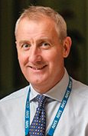
Thank you David
Previous BAUS Regional Rep’ & Trustee

Slide 3
What is happening:
Responding to COVID
Guidelines from sections
Virtual Educational activities e.g. Webinars / FRCS Urol course etc
Virtual BAUS 2020
TOB - keen to rethink sections and their structure (again nothing definite)

Slide 4
BAUS Annual Meeting
Lots of discussion about future formats
‘A poster from every unit’
Incorporate annual meeting fee in subscriptions to encourage attendance (not confirmed)
Plans for 2021 - still to be decided

Slide 5
BAUS Audit
BAUS contract with Dendrite ends March 2021
Individuals can download data before 31st Jan’ 2021
Summary data from BAUS registries being used to assist benchmarking e.g. RARP
NCIP (National Clinical Improvement Programme) aim to deliver consultant outcomes - work ongoing
There is now an Audit Steering Group - more focussed on time limited audits e.g. BOO audit
Follow up data still being collected for Cytoreductive nephrectomy audit
Renal Colic Audit - recently launched

Slide 6
BAUS National Fellowship Directors
Anthony Koupparis (Oncology)
Melissa Davies (Benign)
We all await more information as to how they will actually facilitate UK fellowships

Slide 7
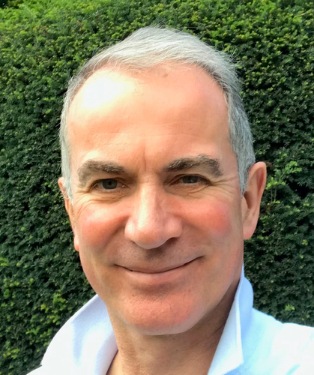
A strategic vision for BAUS
Published in this months BJUI
Core goals of BAUS:
  The development, education and support of urologists in their work;
  for BAUS to be a leading influence in urology in the UK and the world;
  and to become more efficient and effective in our internal workings.

Slide 8
Please feel free to contact me if you have ideas or comments regarding anything in Tim’s recent article on Strategic vision:
mark.johnson27@nhs.net
Thanks

